Slide 1
Netflix Challenge (2007): Who rated what?
Team 6
Evan Bosia
Ledia Gebremedhin
Rahaf Alharbey
Bobby McDonough
Boston University & CS 542 Machine learning
07/1/2021

Slide 2

01
02
03
04
Challenge Info
Background
Data Methods
Results and Discussion

Slide 3

01
Challenge Info
Introduction

Slide 4

Challenge Background
KDD 2007 Cup: Who Rated What?
Our team’s task is to predict which users rated which movies in 2006.
We were provided a list of 100,000 (user_id, movie_id) pairs where users and movies are drawn from the Netflix Prize training dataset
Netflix Prize Dataset consisted of 100+ million movie ratings by 480k users on 17.7k movies

Slide 5
KDD 2007 Cup Tasks
Task 1 - predict which users rated which movies in 2006
Netflix provide a list of 100,000 (user_id, movie_id) pairs where the users and movies are drawn from the Netflix Prize training data set
Task 2 - predict the number of additional ratings the users from the Netflix Prize training dataset gave to a subset of the movies in the training dataset
Netflix provide a list of 8863 movie_ids drawn from the Netflix Prize training dataset

Slide 6


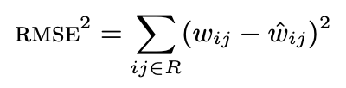
First PAPER Methods
A naive estimate based on a user–movie independence assumption that uses time series analysis and event prediction
Predict the marginal probabilities and using their product for a “Who Rated What” prediction based on the assumption that movies and users are independent.

Slide 7

Second Paper Methods
1
2
3
selection of the explanatory variables
Sampling Algorithm
logistic Regression
The data set was divided into parts based on a time window, the researchers used a time window of 1 year.
Three types of variables were formed for modeling movie variables, user variables, and movie-user interaction variables.
The logistic regression was used to model the data but the input data features were transformed using decision trees and were named as intelligent variables

Slide 8
03
Data Methods

Slide 9
Dataset
Supplied training data has 100 million instances
Only four features: User ID, Movie ID, Rating, Date
Notable Implications:
Not a lot of features to work with
Only positive data
Additional features were possible through 3rd party websites (IMDB)
Need to create synthetic negatives

Slide 10

Feature Engineering
Users | Movies
Total Ratings
Total Ratings in 05
Average Rating
Ratings by Day
Entry Year

Slide 11

Random Sampling of Dataset
All Movies and users were segmented by year
No User is checked for not rating a Movie that was not on Netflix when they were active
User/Movie combos were then separated and randomly sorted to create new user/movie pairs
Pairs were then checked against the training dataset to confirm that the match is a true negative

Slide 12
04
Results and Discussion

Slide 13

Model Selection
Gradient Boosting
combines weak "learners" into a single strong learner iteratively
each iteration adds a weak learner trained off the previous error
excellent on big data problems → challenge has lots of data
poor on extrapolating data → not a problem here
LightGBM is a framework developed by Microsoft for gradient boosting

Slide 14
Experiments
Maxed recommended hyperparameters
Large amount of data so overfitting is less likely
Trained on 50M instances
Trained 100, 250, 500, 1000, and 10000 iterations
Diminishing returns:
Training Iterations | Model Size (MB) | Recall(+) | RMSE
1000 | 94 | 0.2 | 0.42
10000 | 856 | 0.23 | 0.45
Notes:
Higher RMSE means the negatives were not called as well

Slide 15
Results
Model performed pretty poorly
Accuracy: 0.81
Recall(+): 0.20 - Precision(+): 0.12
Confusion Matrix:
Positives are called poorly
Uncertainty in both positives and negatives
Guessing 0 would result in 10th place!
Model | Accuracy | RMSE
LightGBM | 0.81 | 0.4579
Guessing “0” | 0.922 | 0.279
Actual \ Predict | 0 | 1
0 | 80274 | 11922
1 | 6215 | 1589
Notes:
Accuracy does not show the whole picture because the answer data is very skewed (92% negative)
Guessing 0, while it has good RMSE, does not attempt to solve the problem of “Who rated what?” so I don’t feel bad about not being as good as it

Slide 16
Discussion (how to improve)
Use more / better features
Some features are highly correlated (next slide)
Time since last rating, genre, etc ~ link to IMDB dataset
Improve negative generation:
pick users and movies that are less prevalent for “negatives”
intuition is users that rated less are more likely to be negative
Pick better hyperparameters
Notes:
Pick better hyperparameters

Slide 17
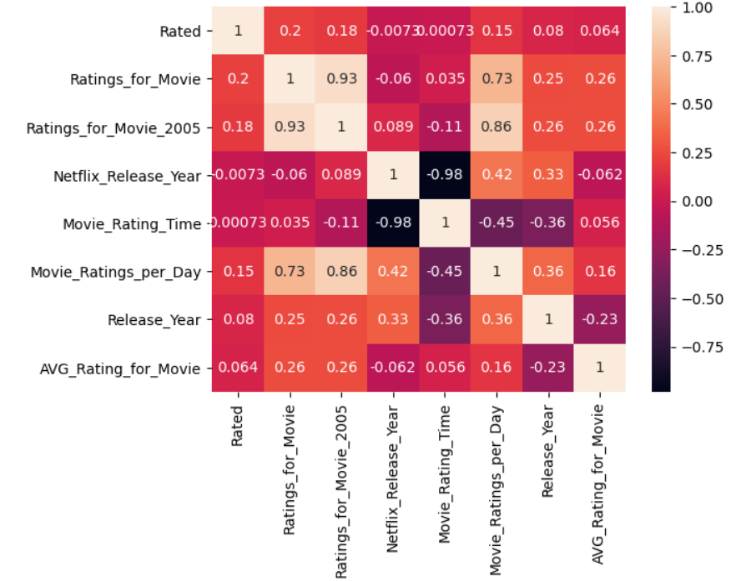
Feature Correlation Matrix
Some features are strongly correlated
Ratings and Ratings (2005)
Ratings (2005) and Ratings per day
Limits the useable information to train off of

Slide 18
Conclusion
Quality of data is very important
Can use feature engineering to get more data
Generating synthetic data with idea of distribution
Model selection is less important than the quality of data
LightGBM models have diminishing returns when training more iterations
Larger model → slower predictions

Slide 19

Thanks!
Do you have any questions?

